Slide 1
Data Structures

Slide 2
We’re going to cover…
Data structures
Lists, tuples, and dictionaries
Multi-dimensional data structures
Examples of using data structures
Applying data structures
at a high level for now

Slide 3
A list of numbers
1 x 5 = 5
2 x 5 = 10
3 x 5 = 15
4 x 5 = 20
5 x 5 = 25
6 x 5 = 30
7 x 5 = 35
8 x 5 = 40
9 x 5 = 45
10 x 5 = 50
what are we paying attention to?
what is interesting to us?
what is the same? what changes?

Slide 4
A list of numbers
1 x 5 = 5
2 x 5 = 10
3 x 5 = 15
4 x 5 = 20
5 x 5 = 25
6 x 5 = 30
7 x 5 = 35
8 x 5 = 40
9 x 5 = 45
10 x 5 = 50
(product is the result of a multiplication)
multiplier x 5 = product
variable
variable
doesn't change
what is the same? what changes?

Slide 5
A list of numbers
1 x 5 = 5
2 x 5 = 10
3 x 5 = 15
4 x 5 = 20
5 x 5 = 25
6 x 5 = 30
7 x 5 = 35
8 x 5 = 40
9 x 5 = 45
10 x 5 = 50
what are we paying attention to?
what is interesting to us?
should we make this a collection?
should we make this a collection?
multiplier x 5 = product
(let's assume that only the multiplier needs to be a collection)

Slide 6
A list of numbers
1 x 5 = 5
2 x 5 = 10
3 x 5 = 15
4 x 5 = 20
5 x 5 = 25
6 x 5 = 30
7 x 5 = 35
8 x 5 = 40
9 x 5 = 45
10 x 5 = 50
what are we paying attention to?
what is interesting to us?
there is an arithmetic progression
the start point is 1, the end point is 10,
the order matters, and there are increments of 1
multipliers = [1, 2, 3, 4, 5, 6, 7, 8, 9, 10]

Slide 7
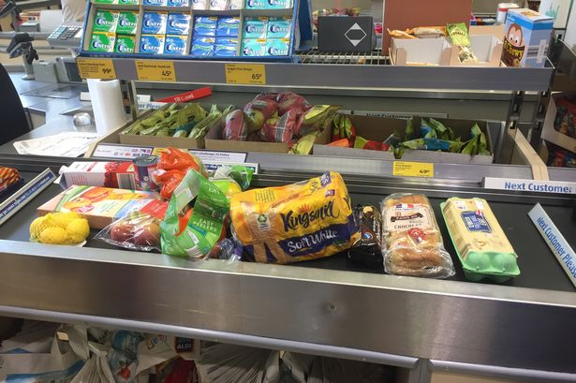

A collection of shopping items
price?
barcode?
description?
name?
what are we paying attention to?
what is interesting to us? what is our purpose?
what is common? why treat them as a collection?
item type?

Slide 8
Abstraction
We're beginning to think about abstraction
Abstraction is like a lens
It allows us to ignore what we don't need (take out of focus)
In order to concentrate on what we do need (bring into focus)
I don't want to get too carried away with this – we're only considering relatively simple data at this point

Slide 9

A graduation ceremony
what is interesting to us? what is our purpose?
what is common? why treat them as a collection?

Slide 10
Where is the collection?
Problem – Rainfall:
prompt user for the rainfall in mm for each month of the year
output a histogram of the rainfall month by month

Slide 11
Where is the collection?
as an initial 'stab' we're interested in the months of the year
Problem – Rainfall:
prompt user for the rainfall in mm for each month of the year
output a histogram of the rainfall month by month

Slide 12
What are we interested in?
Problem – Rainfall:
prompt user for the rainfall in mm for each month of the year
output a histogram of the rainfall month by month
but we're also interested in the average rainfall in mm for each month

Slide 13
Rainfall
(more on this in the demonstrations)
Jan = 187mm
Feb = 168mm
Mar = 65mm
Apr = 58mm
May = 97mm
Jun = 53mm
Jul = 56mm
Aug = 146mm
Sep = 18mm
Oct = 153mm
Nov = 123mm
Dec = 131mm
we're interested in the month name
and the average rainfall in mm

Slide 14
Any questions?

